Slide 1



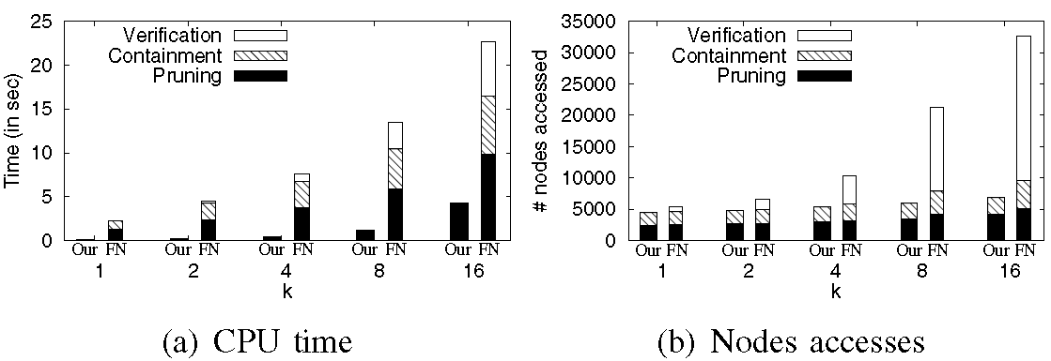
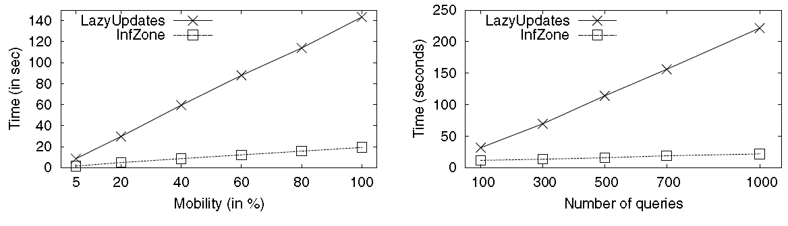
Influence Zone: Efficiently Processing
Reverse k Nearest Neighbors Queries
Muhammad Aamir Cheema, Xuemin Lin, Wenjie Zhang, Ying Zhang
University of New South Wales, Australia
Taste it here ...
Reverse k Nearest Neighbors (RkNN) Query
Return every object for which query object is one of the k closest objects.
Contributions
We solve
RkNN queries on both static and dynamic datasets
both bichromatic and monochromatic RkNN queries
Our algorithm outperforms existing algorithms for both static and dynamic datasets.
Comprehensive theoretical analysis is conducted which is verified by the experimental study
C₂
f₃
C₁
f₂
f₁
q
C₃
Example
Fuel station f₁ is the query point.
Its reverse nearest neighbor (k=1) is every car for which f₁ is the closest fuel station.
C₂ and C₃ are the RNNs of f₁. Although C₁ is the nearest car to f₁ it is not its RNN.
RkNNs are the potential customers of a fuel station.
Like it? Read the recipe
Benefits
Existing Algorithms
Our Algorithm
Pruning
Pruning
Prune the data space
Compute influence zone *
Containment
Containment
Snapshot RkNN Algorithms (Our vs FN)
Candidates = objects in the unpruned space
Result = objects that are inside the influence zone
Verification
Verify each candidate object if q is one of its k nearest neighbors
* Influence zone Z_{k} is the area such that a point p is the RkNN of q iff p is inside Z_{k}
Continuous RkNN Algorithms (Our vs LazyUpdates)
Still hungry? Please have more
COMPUTING INFLUENCE ZONE Z_{k}
Naive Algorithm
For every fuel station f
Draw the half-space between f and q
Influence zone = the area pruned by at most (k-1) half-spaces
Proposed Algorithm
All fuel stations are indexed by R-tree
Z_{k} = the data universe
Initialize a min-heap with root of R-tree
While heap is not empty
de-heap an entry e
If e cannot be pruned *
If e is a data object
Draw the half-space between e and q
Update the influence zone Z_{k}
Else
Insert the children of e in the heap
What else is in the paper
_
Several lemmas to obtain the pruning condition for e
Observations to quickly prune certain entries
Proof that the influence zone is always a star-shaped polygon which allows efficient containment checks
Comprehensive theoretical analysis that is verified by the experimental results
C₁
f₃
f₅
f₅
C₂
q
f₂
f₄
f₆
* e can be pruned if for every convex vertex v of Z_{k}, mindist(e,v) > dist(v,q)
The second author was supported by the ARC Discovery Grants (DP110102937, DP0987557, DO0881035), Google Research Award and NICTA.

